Slide 1


Hoshimov Mirzohamidullo

Slide 2

Outline
Executive Summary
Introduction
Methodology
Results
Conclusion
Appendix

Slide 3
Executive Summary
Summary of methodologies
Data Collection through API
Data Collection with Web Scraping
Data Wrangling
Exploratory Data Analysis with SQL
Exploratory Data Analysis with Data Visualization
Visual Analytics with Folium
Machine Learning Prediction
Summary of all results
Exploratory Data Analysis with SQL
Interactive analytics charts
Predictive Analytics result

Slide 4
Introduction
Project background and context
SpaceX's Falcon 9 launches are much cheaper (around $62 million) than competitors (over $165 million) because they reuse the first stage.. Therefore, if we can determine if the first stage will land, we can determine the cost of a launch. This information can be used if an alternate company wants to bid against space X for a rocket launch. This goal of the project is to create a machine learning pipeline to predict if the first stage will land successfully.
Problems you want to find answers
What are the factors if the rockets will land successfully?
The influence of different features that determine the success rate of a successful landing.
What conditions are required to ensure a successful landing outcome?

Slide 5

Section 1

Slide 6
Methodology
Executive Summary
Data collection methodology:
Data was collected from two sources:
Official API of SpaceX: (https://api.spacexdata.com/v4/rockets/)
Wikipedia Page Web Scraping : (https://en.wikipedia.org/wiki/List_of_Falcon/_9/_and_Falcon_Heavy_launches)
Perform data wrangling
After the summarization and analysis the landing outcome was labeled as True and False based and feature metrics

Slide 7
Methodology
Executive Summary
Perform exploratory data analysis (EDA) using visualization and SQL
Perform interactive visual analytics using Folium and Plotly Dash
Perform predictive analysis using classification models
First data was cleaned, performed one-hot encoding and normalization to ensure scaling, divided into test and training sets. Evaluation was based on four classification models (Decission Tree, KNN, Logistic Regression, SVM). The best hyperparameters were selected by using GridSearchCV, which gave the most optimal parameters. According to the accuracy outcome Decision Tree was the best performing model

Slide 8
Data Collection
Describe how data sets were collected.
Data was collected from SpaceX API (https://api.spacexdata.com/v4/rockets/)
As well as from Wikipedia (Web Scraping)
(https://en.wikipedia.org/wiki/List_of_Falcon/_9/_and_Falcon_Heavy_launches),

Slide 9
Data Collection - SpaceX API
Requesting to API and getting SpaceX Data
Filtering and including only Falcon 9 launches
Handling Missing values
SpaceX has publicly available API where the data can be accessed
Above you can see the flowchart how API was used
Notebook with code:
https://github.com/Hafizulloevich/IBM-Data-Science-Professional-Certificate/blob/f657cc1a4e03fb0333d9da75f15ad8db70fb2384/Applied%20Data%20Science%20Capstone/Data_Collection_API.ipynb

Slide 10
Data Collection - Scraping
Requesting to Wikipedia page
Extracting Falcon 9 launches
Parsing the data into a dataframe
Wikipedia page was used for Web Scraping to obtain the SpaceX data;
• Data are downloaded from Wikipedia according to the flowchart and then persisted
Notebook with code:
https://github.com/Hafizulloevich/IBM-Data-Science-Professional-Certificate/blob/f657cc1a4e03fb0333d9da75f15ad8db70fb2384/Applied%20Data%20Science%20Capstone/Webscraping.ipynb

Slide 11
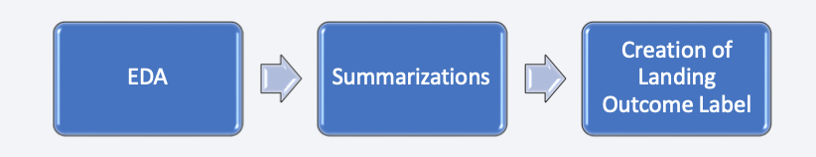
Data Wrangling
Exploratory data analysis were performed with SQL Queries as well as with Visualization techniques.
The steps are in the below flowchart
https://github.com/Hafizulloevich/IBM-Data-Science-Professional-Certificate/blob/5942be6963663aba6e4d486717ff6731677d1357/Applied%20Data%20Science%20Capstone/Data%20Wrangling.ipynb

Slide 12
EDA with Data Visualization
The following actions were performed:
Visualize the relationship between Flight Number and Launch Site
Visualize the relationship between Payload and Launch Site
Visualize the relationship between success rate of each orbit type
Visualize the relationship between FlightNumber and Orbit type
Visualize the relationship between Payload and Orbit type
Visualize the launch success yearly trend
These graphs were generated to understand the relationships between variables
https://github.com/Hafizulloevich/IBM-Data-Science-Professional-Certificate/blob/66e4922e384c6c8c08ebe52edebe6ce5cc697a9a/Applied%20Data%20Science%20Capstone/EDA%20with%20Data%20Visualization.ipynb

Slide 13
EDA with SQL
SQL queries were performed:
Distinct Launchpads for the space mission;
The top 5 launch sites with ‘CCA’ naming
Average payload mass carried by booster version F9 v1.1;
Date when the first successful landing outcome in ground pad was achieved;
Names of the boosters which have success in drone ship and have payload mass between 4000 and 6000 kg;
Total number of successful and failure mission outcomes;
Names of the booster versions which have carried the maximum payload mass;
Failed landing out comes, their booster versions, and launch site names for in year 2015;
Rank of the count of landing outcomes (such as Failure or Success) between the date 2010-06-04 and 2017-03-20.
https://github.com/Hafizulloevich/IBM-Data-Science-Professional-Certificate/blob/66e4922e384c6c8c08ebe52edebe6ce5cc697a9a/Applied%20Data%20Science%20Capstone/EDA_SQL.ipynb

Slide 14
Build an Interactive Map with Folium
Markers, circles, lines and cluster markers were created using Folium Maps
Launch sites were illustrated by Markers;
Circles were used to indicate areas around specific coordinates, like NASA Johnson Space Center;
Marker clusters highlighted events in each coordinate, like launches sites
Lines are used to indicate distances between two coordinates.
https://github.com/Hafizulloevich/IBM-Data-Science-Professional-Certificate/blob/56438816da6152cd403f1d3c8918d1584bf6ed8c/Applied%20Data%20Science%20Capstone/Folium_Visualization.ipynb

Slide 15
Build a Dashboard with Plotly Dash
We generated a dashboard with Plotly Express and Dash
Pie charts illustrating successful Launches for certain sites were created
Created scatterplots to show the Relationship of Payload Mass vs Success Rate
We added a slider to select the payload range
https://github.com/Hafizulloevich/IBM-Data-Science-Professional-Certificate/blob/71542d09ec1846c523ce1272c82db940b4c5f9e4/Applied%20Data%20Science%20Capstone/spacex_dash_visualizations.py

Slide 16
Predictive Analysis (Classification)
We imported the data with pandas, transformed it with NumPy and Pandas, and divided it into training and testing sets.
We developed various machine learning models and adjusted their hyperparameters using GridSearchCV.
We evaluated our models using accuracy, enhancing them through feature engineering and algorithm optimization.
We identified the top-performing classification model
https://github.com/Hafizulloevich/IBM-Data-Science-Professional-Certificate/blob/71542d09ec1846c523ce1272c82db940b4c5f9e4/Applied%20Data%20Science%20Capstone/SpaceX_Machine_Learning.jupyterlite.ipynb

Slide 17
Results
SpaceX used 4 launch sites in Houston
First successful landing was performed in 2015
The average Payload of Falcon 9 is 2928 kg
Most launches with payload mass under 10,000 kg are from any launch site, but heavier ones happens mainly at CCAFS SLC 40 and KSC LC 39A
As more time passed as more successful landings increased

Slide 18

Section 2

Slide 19
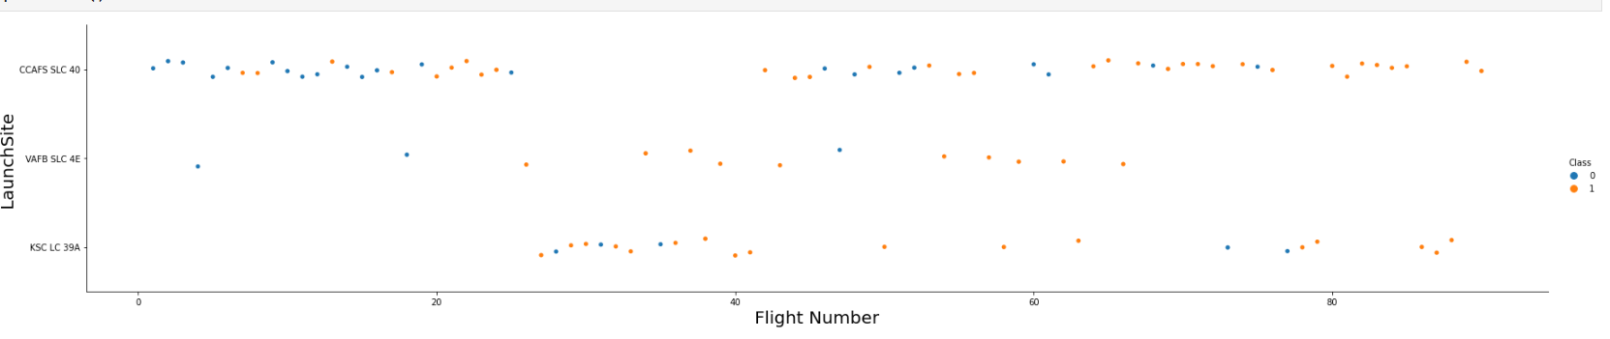
Flight Number vs. Launch Site
As we can see, the more flights are in the launch site, the more successful landing it has. The most successful launch site is CCAFS SLC 40

Slide 20
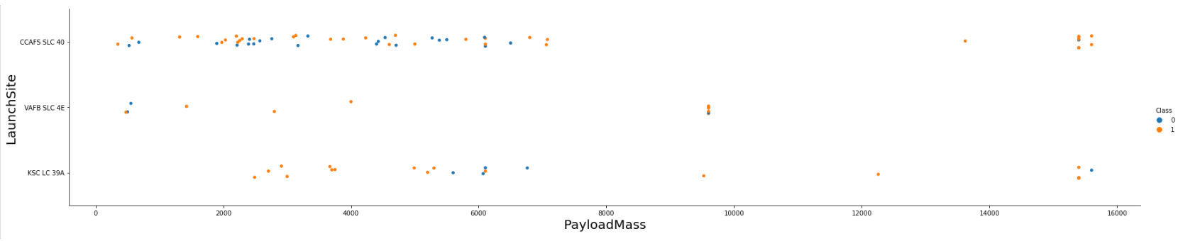
Payload vs. Launch Site
From the chart we see that launches with Payload Mass higher 8000 have most successful landing outcomes

Slide 21
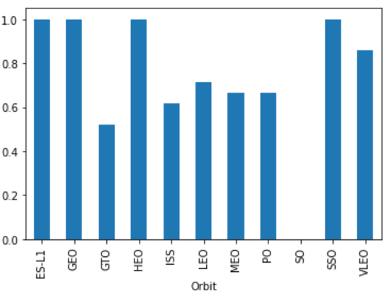
Success Rate vs. Orbit Type
As illustrated ES-L1, GEO, HEO, SSO have success rate of 100%

Slide 22
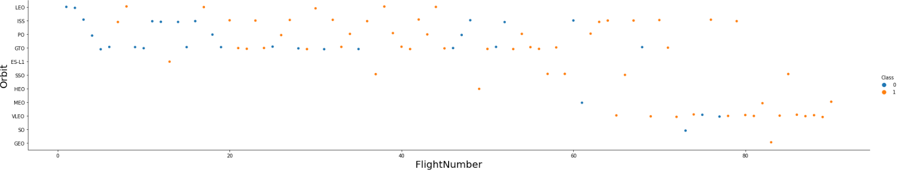
Flight Number vs. Orbit Type
The flights to ISS VLEO and LEO mostly had successful landing. Moreover, as more flights in the orbit as more successful landing it gets.

Slide 23
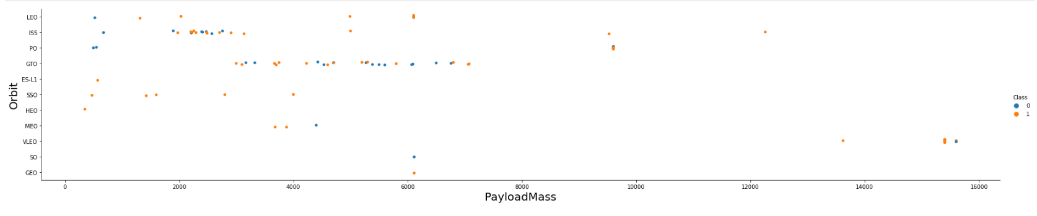
Payload vs. Orbit Type
Most of the launches to the orbits are below the Payload Mass of 8000. Launches to GTO and ISS mostly had not landed successfully.

Slide 24
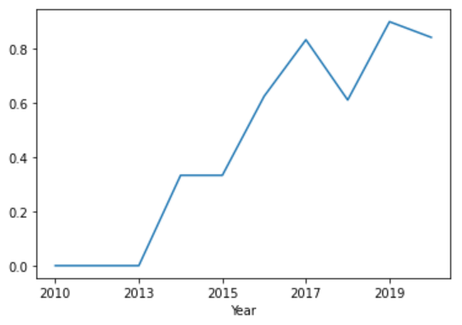
Launch Success Yearly Trend
Each year successful landings increased. In 2019 success rate was almost 100%

Slide 25
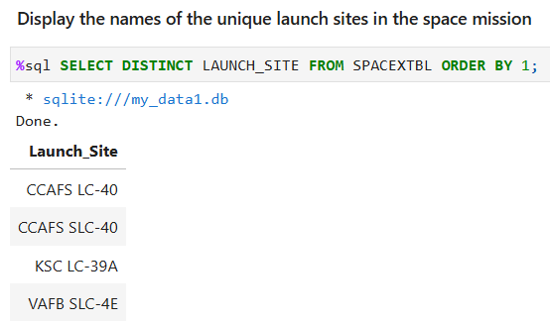
All Launch Site Names
There are 4 launch sites were used to launch the rockets

Slide 26
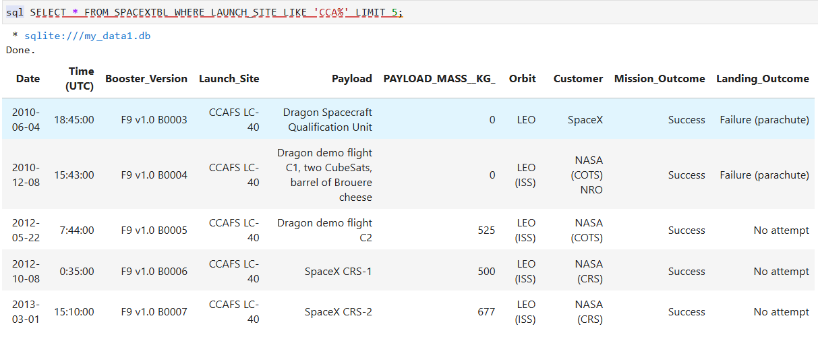
Launch Site Names Begin with 'CCA'
5 Launch sites that begin with `CCA`

Slide 27
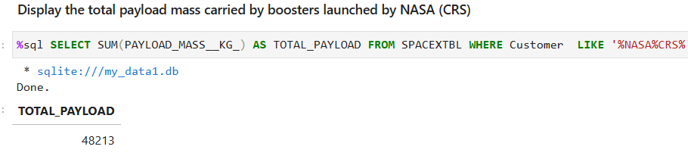
Total Payload Mass
In the below photo you can see the total payload for NASA(CRS) is 48213

Slide 28
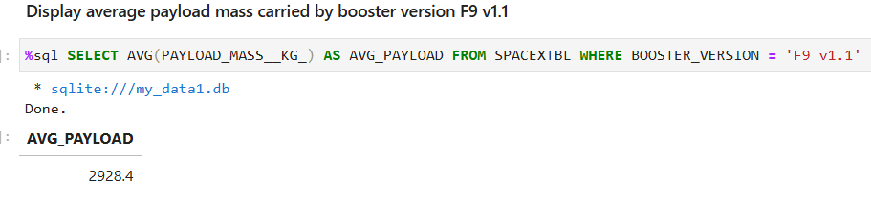
Average Payload Mass by F9 v1.1
The average payload mass carried by booster version F9 v1.1
is 2928 kg.

Slide 29
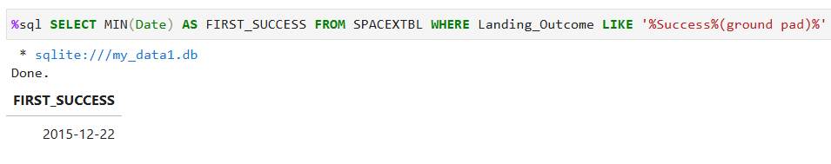
First Successful Ground Landing Date
The first successful landing was on 22nd of December in 2015

Slide 30
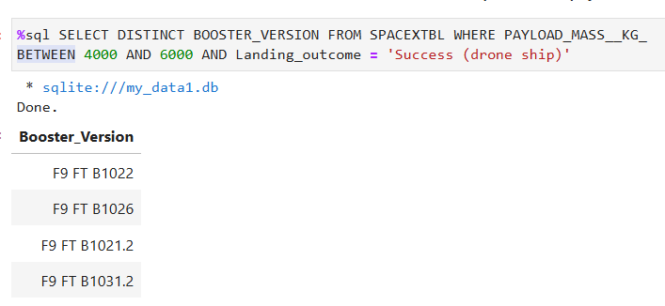
Successful Drone Ship Landing with Payload between 4000 and 6000
Booster versions which were successful in drone ship landing are F9 FT group

Slide 31
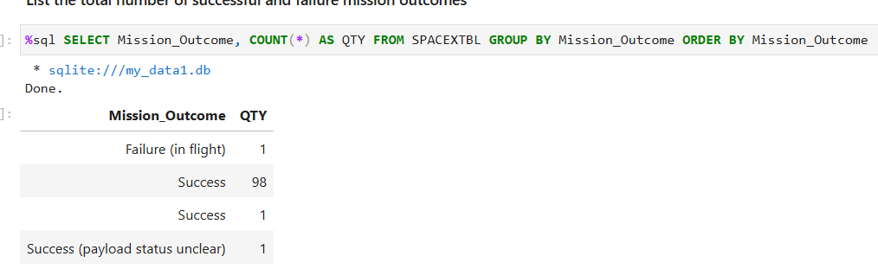
Total Number of Successful and Failure Mission Outcomes
The number of Successful mission outcomes are 100, while failure outcomes are 1

Slide 32
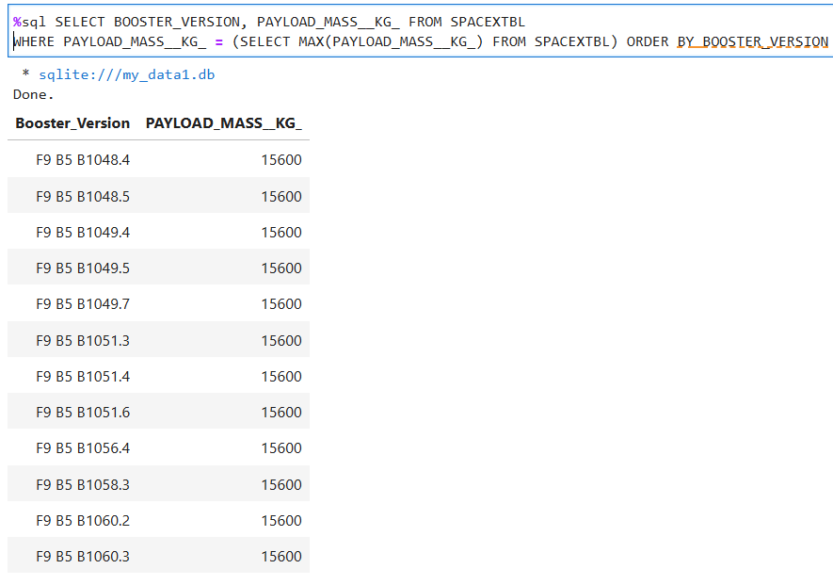
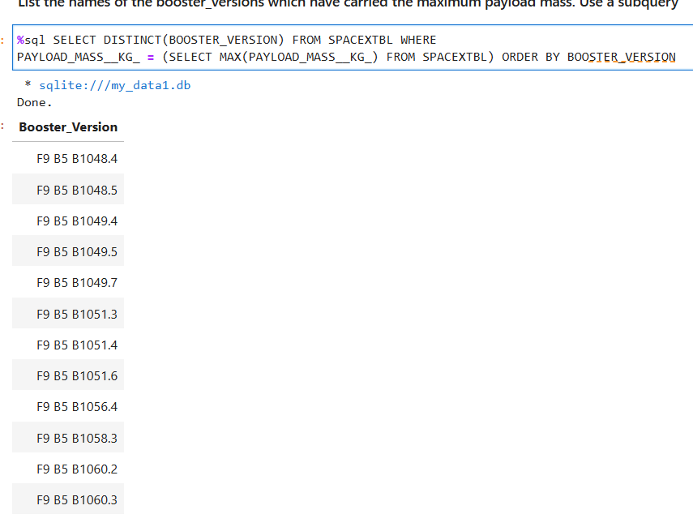
Boosters Carried Maximum Payload
Booster Version from F9 B5 type have highest payload of 15600kg

Slide 33
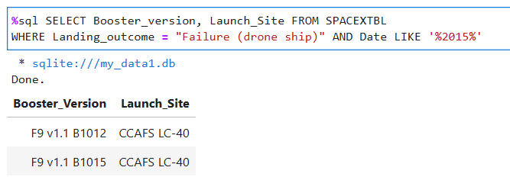
2015 Launch Records
Failed landing outcomes in drone ship with their booster versions, and launch site names for year 2015

Slide 34
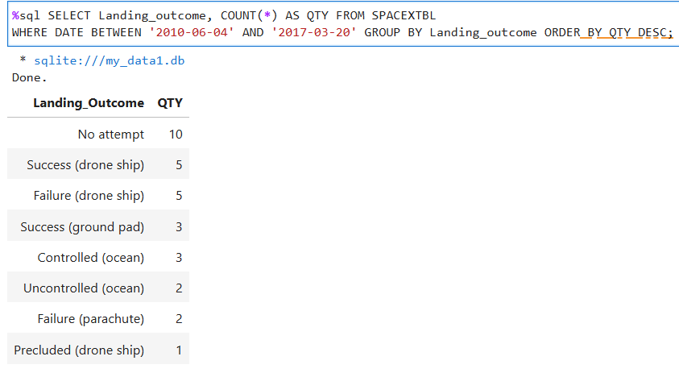
Rank Landing Outcomes Between 2010-06-04 and 2017-03-20
Ranking of landing outcomes (such as Failure (drone ship) or Success (ground pad)) between the date 2010-06-04 and 2017-03-20, in descending order

Slide 35

Section 3

Slide 36
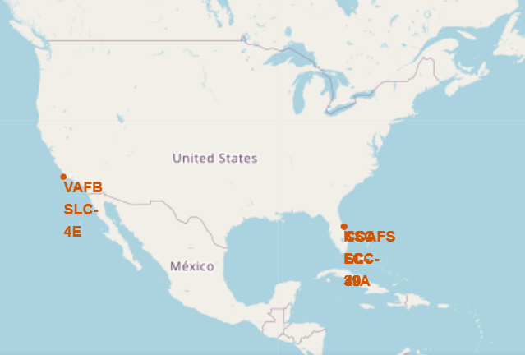
Location of the SpaceX Launch Sites
SpaceX launch sites are located in USA, near the coastline.

Slide 37
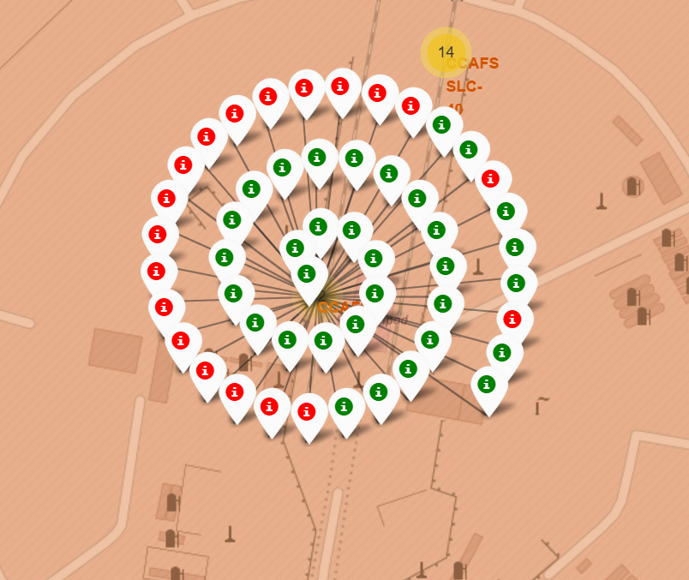
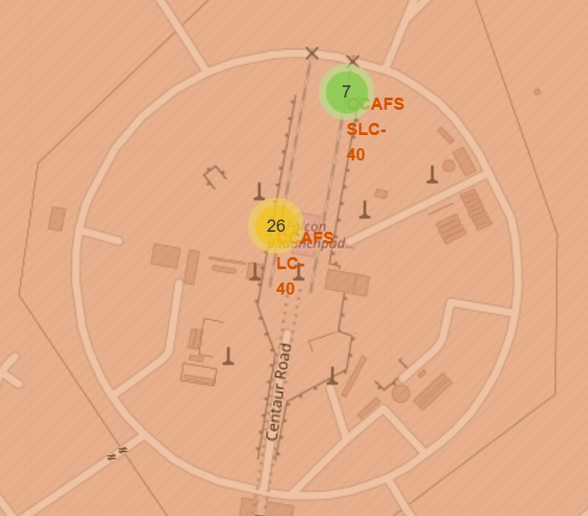
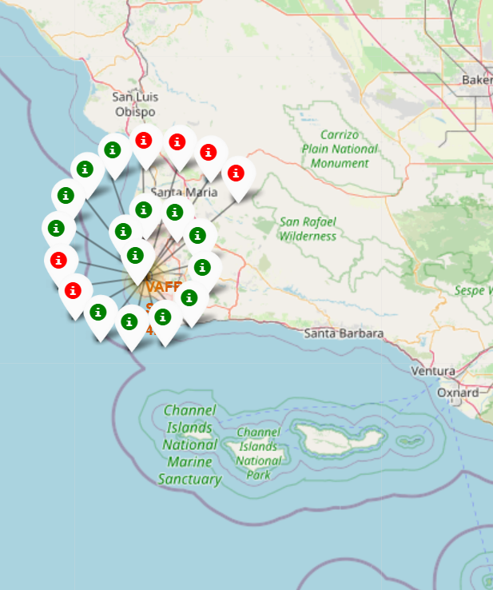
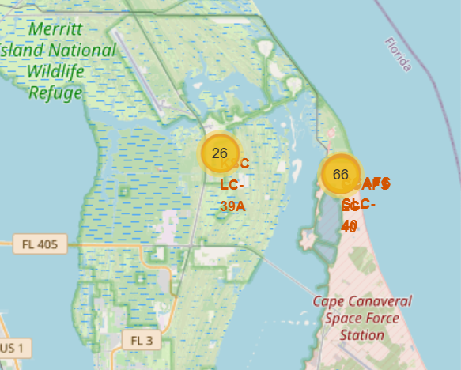
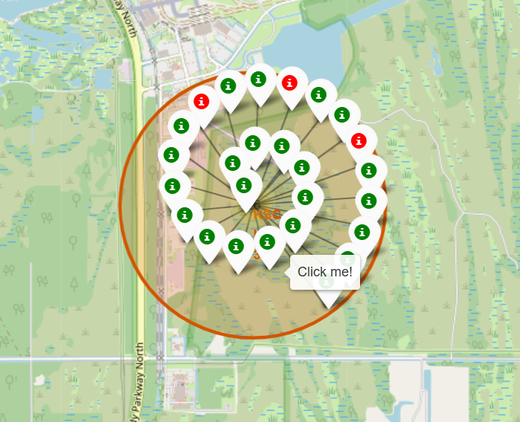
Landing Outcome Indication with markers
Green marker indicates successful landing, while red marker indicates the opposite
Florida based launch sites
There are 92 launches in Florida and 20 in Los Angeles
Los Angeles based launch sites

Slide 38
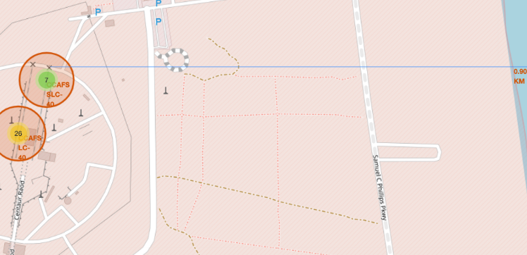
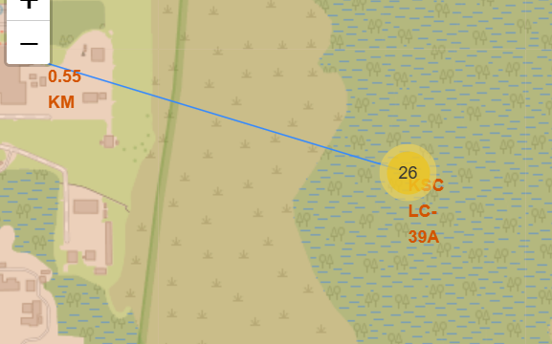
The distance between Coastline and Rail Road
Launch Sites are away from cities.
The distance between launch sites and coastline as well as Rail Road are within 1km

Slide 39

Section 4

Slide 40
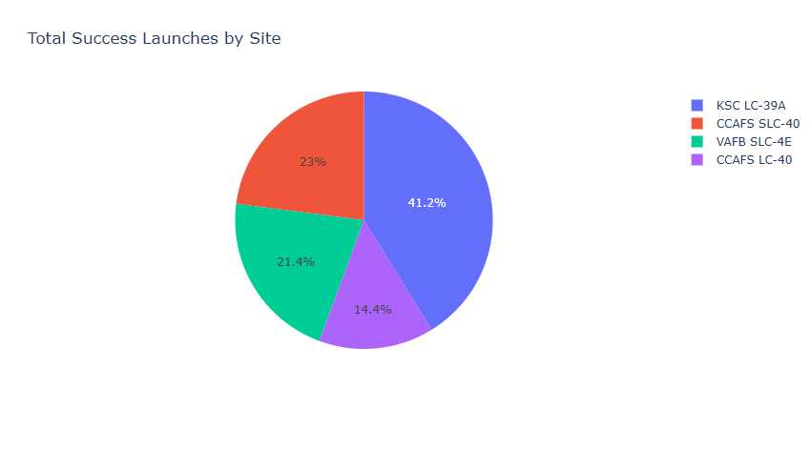
Successful landing percentage of total by each Launch Site
As illustrated in the pie chart, KSC LC-39A had
the largest proportion (41%) of successful landing among
other launch sites.

Slide 41
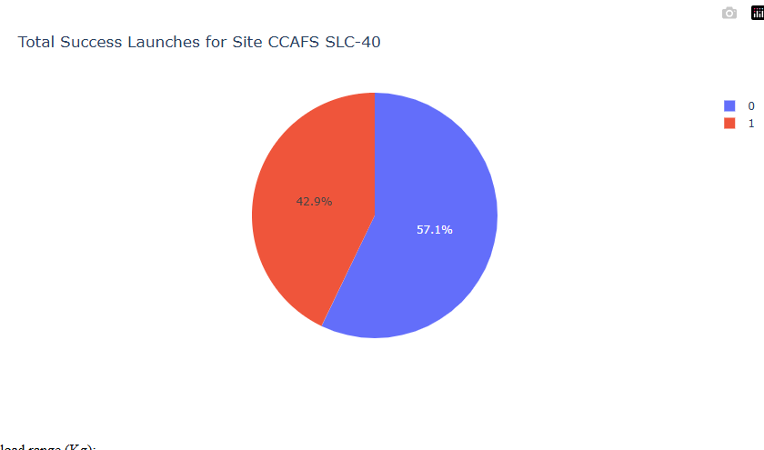
Pie Chart of the largest success to failure ratio launch Site
Launch Site CCAFS SLC-40 had the more
Successful landing results compare to unsuccessful
of 57%

Slide 42
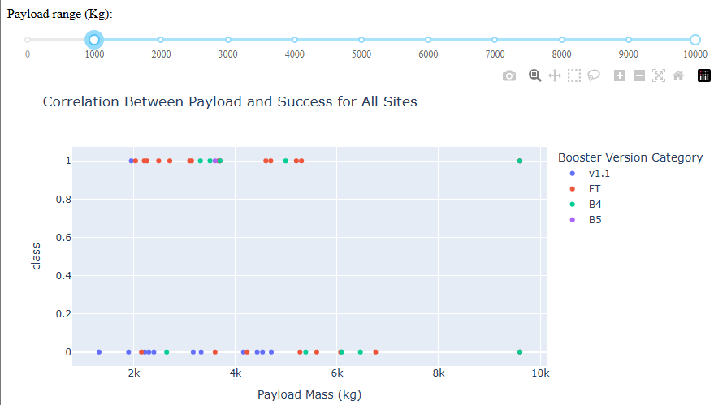
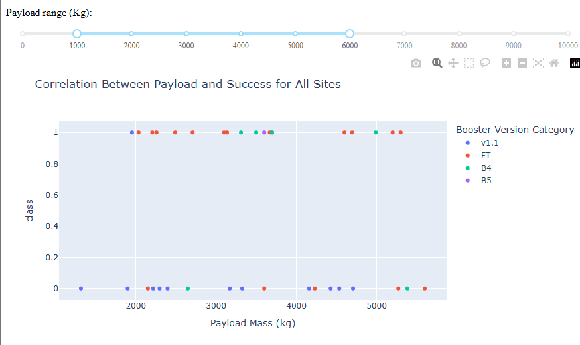
Relationships between Payload vs Landing Outcome

Slide 43

Section 5

Slide 44
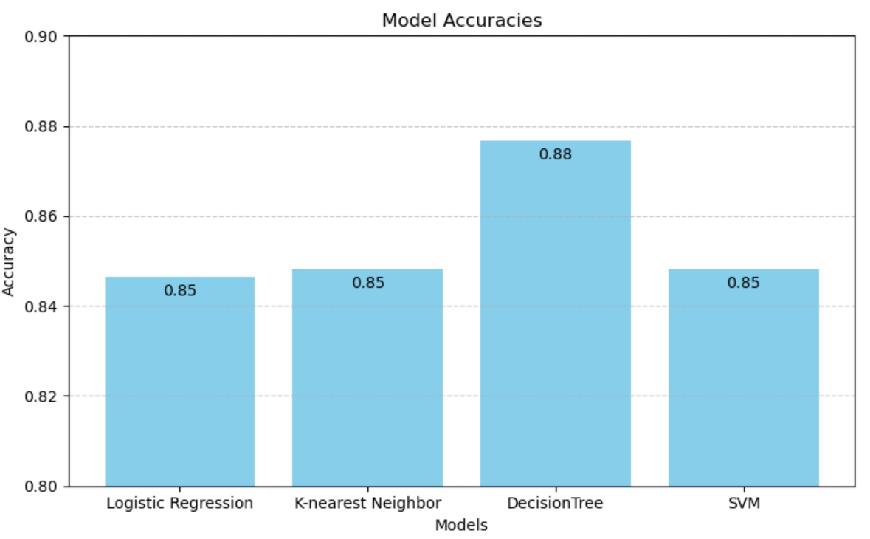
Classification Accuracy
The chart illustrates that Decision Tree classifier has the highest accuracy of 88% and performs best among all of the models

Slide 45
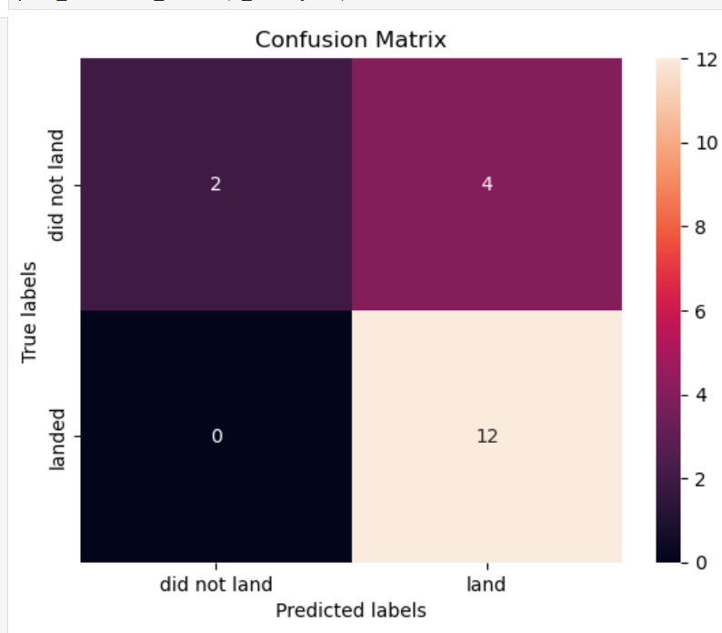
Confusion Matrix
This illustration is the confusion matrix of Decision Tree Classifier. The problem is the False Positive. It means model outputted 4 launches as landed while in reality it did not

Slide 46
Conclusions
In conclusion we can say:
The more flights at a launch site, the greater the success rate at that launch site.
Launch success rate started to increase in 2013 till 2020.
Orbits ES-L1, GEO, HEO, SSO, VLEO had the most success rate.
KSC LC-39A had the most successful launches of any sites.
Payload mass heavier than 8000 guarantees successful landing
The Decision Tree Classifier is the most optimal model for classifying into classes (Success & Fail)

Slide 47


